Slide 1

Predicting Steam Game Prices
Stats 418 Yanze Guo

Slide 2
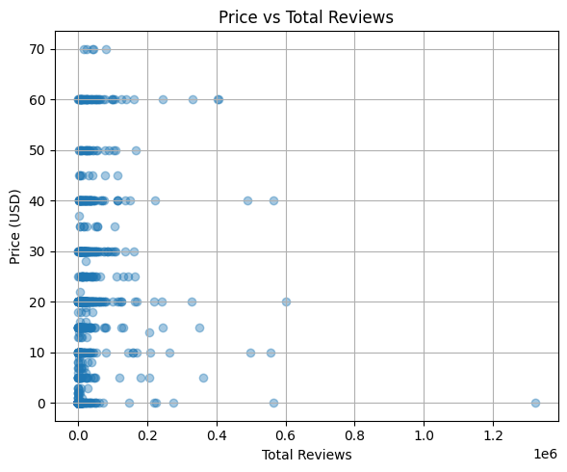
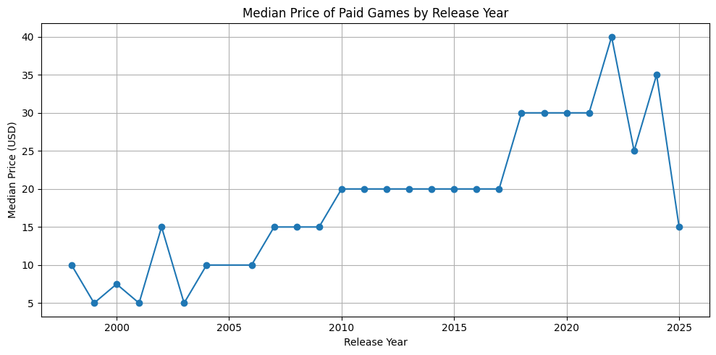
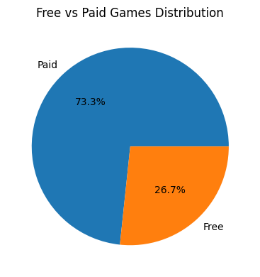
Data Collection & EDA
Data Source
Scraped Top 1,000 Steam games
First used SteamSpy API for popularity rankings
Then queried Steam Store API for:
Price in USD
Release year
Review counts & rating
Genres & multiplayer flag
Output: ~1,000 games × 8 features

Slide 3
Methodology
Cleaning
All free‑to‑play games are removed, leaving ≈ 700 paid entries.
Records missing the year, review stats or price are dropped to keep data clean.
The genres string is split into dummy variables and only genres that appear in ≥ 30 games are kept to avoid sparse noise.
Feature set:
Numeric — release year, positive-review ratio, total reviews
Binary — multiplayer flag plus the genre dummies
Model:
The target is log(price + 1), which normalises the heavy‑tailed price distribution.
Trained a Ridge regression on 80 % of the data and evaluated on the remaining 20 %.
Result
On the held‑out test set the model achieves R² ≈ 0.50
The trained pipeline and genre encoder are saved to model/paid_price_model.pkl for use by the API.

Slide 4
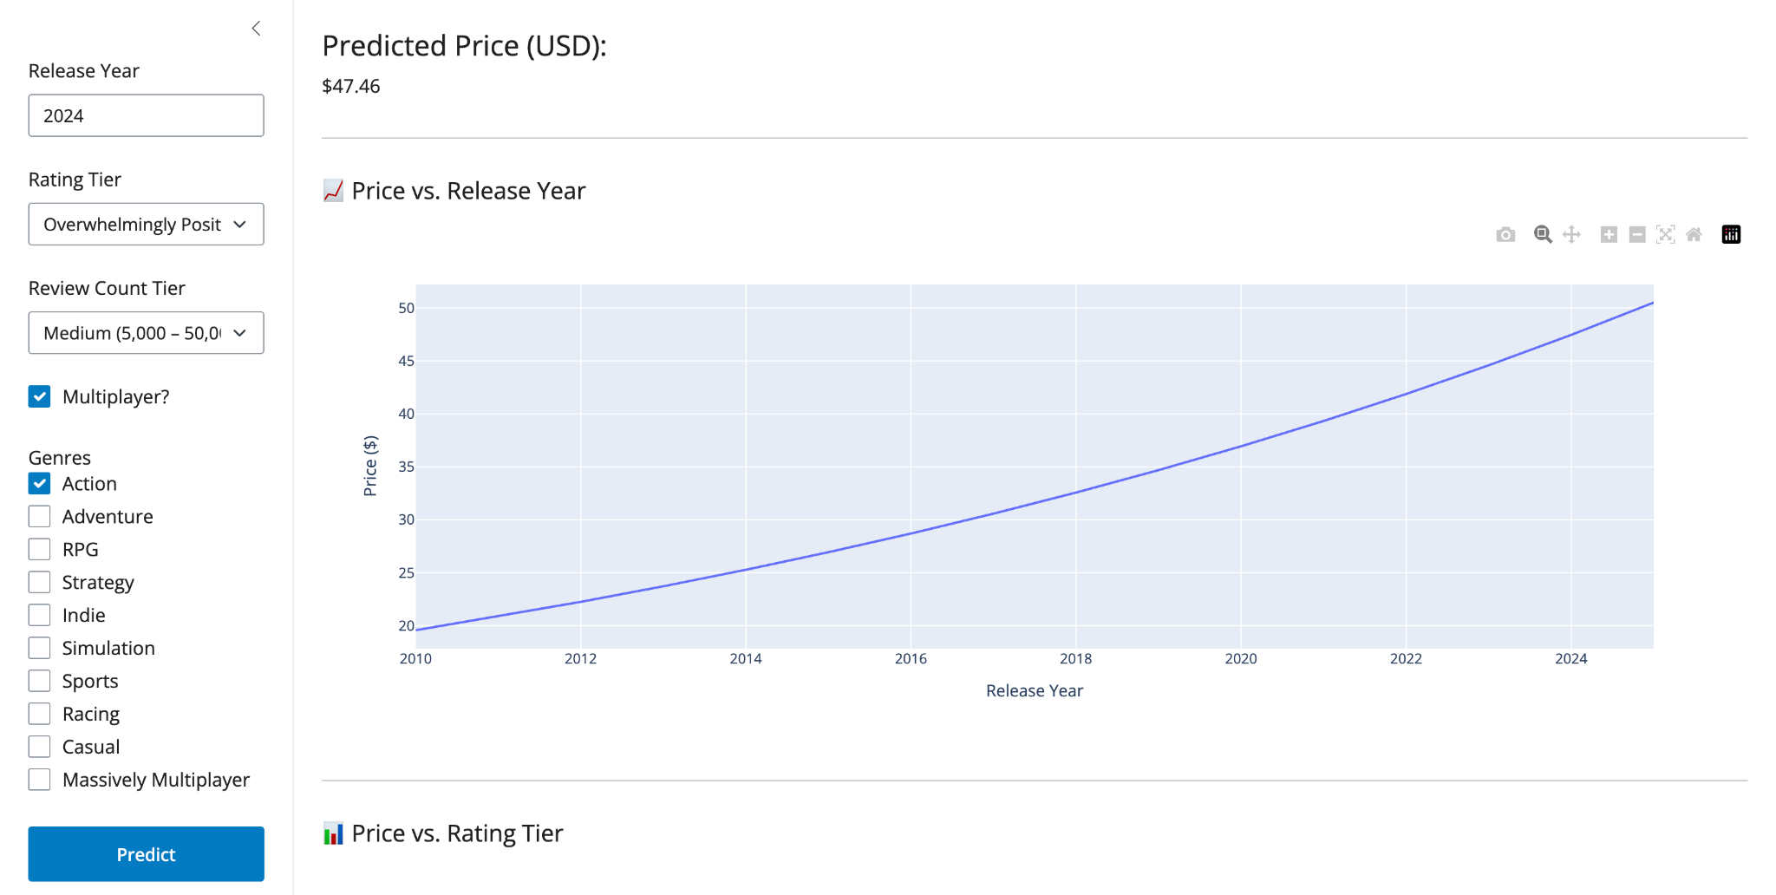
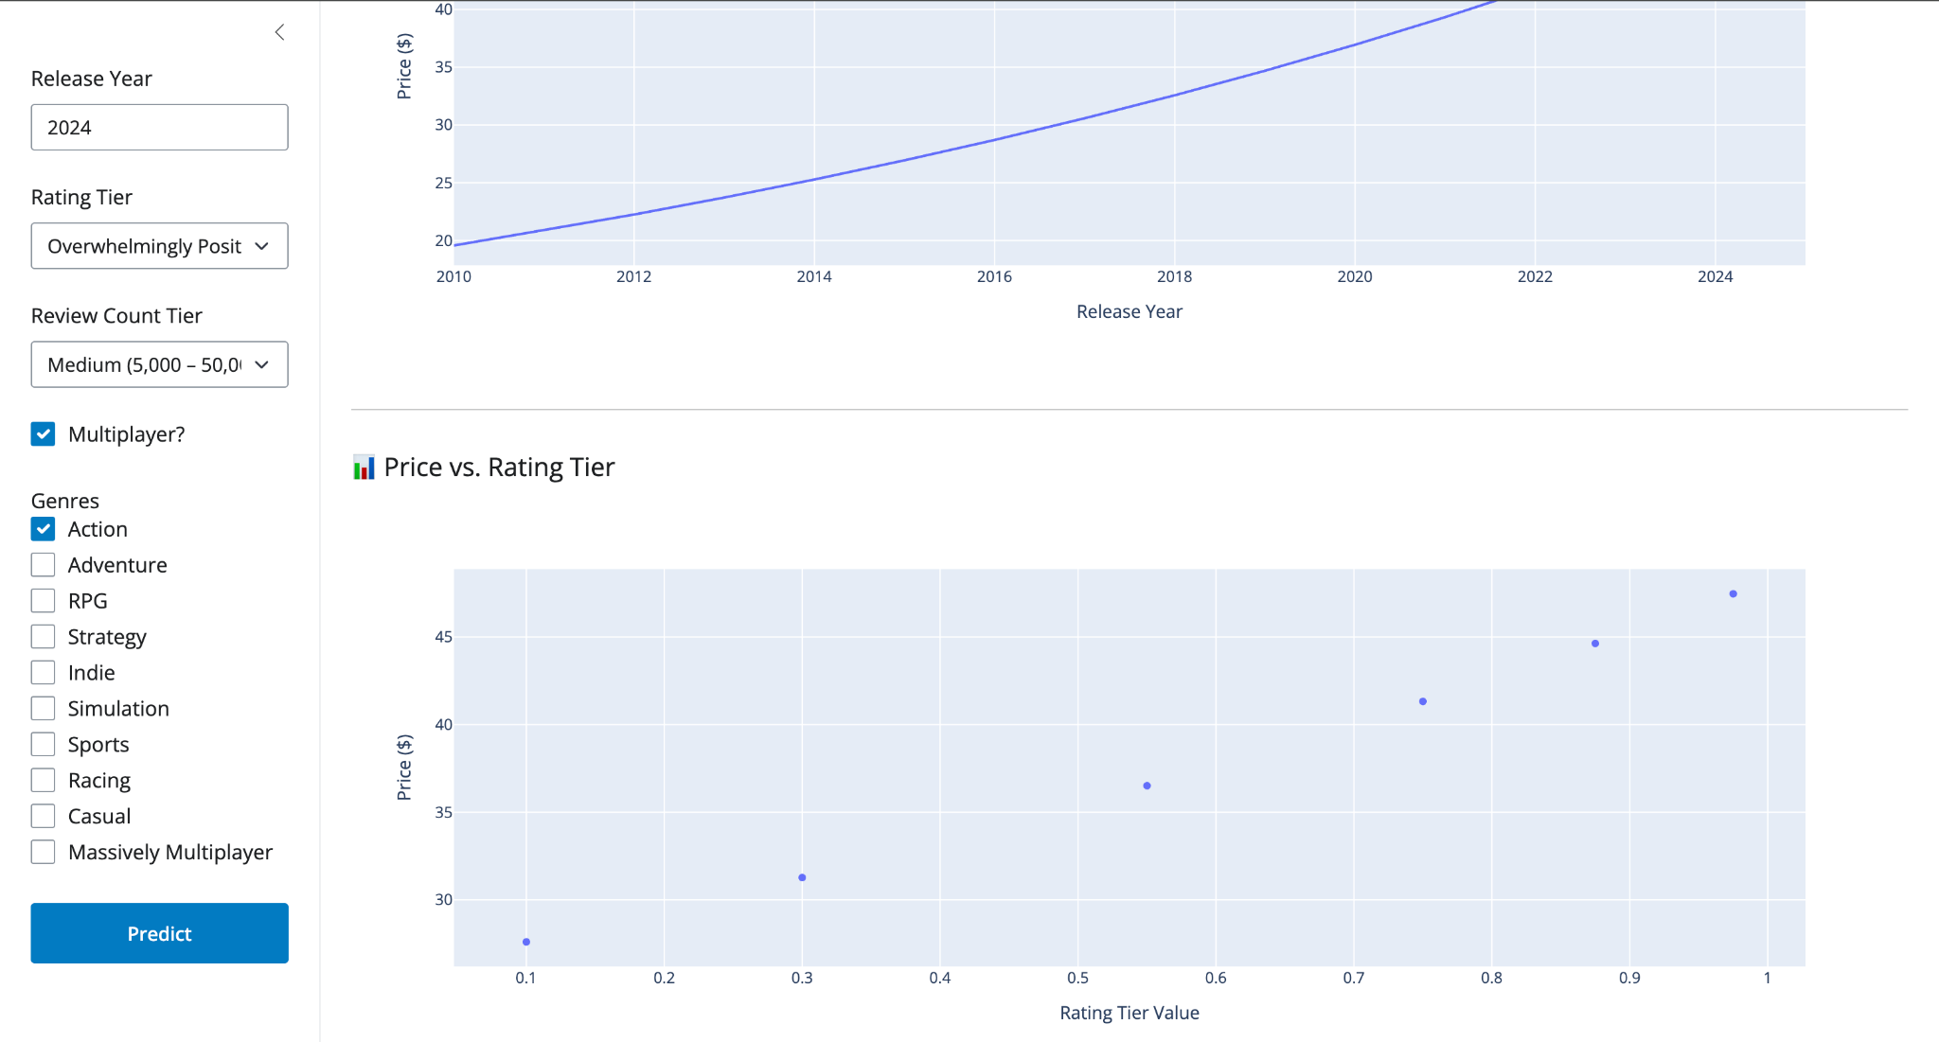
Deployment & Live Demo
Flask API
Endpoint /predict returns price in JSON
Docker to Google Cloud Run
Shiny for Python UI
Sidebar lets users pick year, reviews, rating, genres, multiplayer
Calls the API with requests
Separate Docker to Cloud Run, env var API_URL links to API

Slide 5


Limitations
No discount history or regional pricing
Does not considered free to play games
Game pricing is still partly driven by publisher reputation, promotional strategy, and market conditions—factors our current feature set cannot fully capture.

